Slide 1

Case study: Active Learning via Bayesian Optimization for Discovery of Energy Storage Materials
AI Science Tutorial 2021
“2020 JCESR Best Paper Award”
Hieu A. Doan
Garvit Agarwal
Molecular Materials Group
Materials Science Division
Doan, Agarwal, Qian, Counihan, Rodríguez-López, Moore, & Assary. (2020). https://doi.org/10.1021/acs.chemmater.0c00768

Slide 2
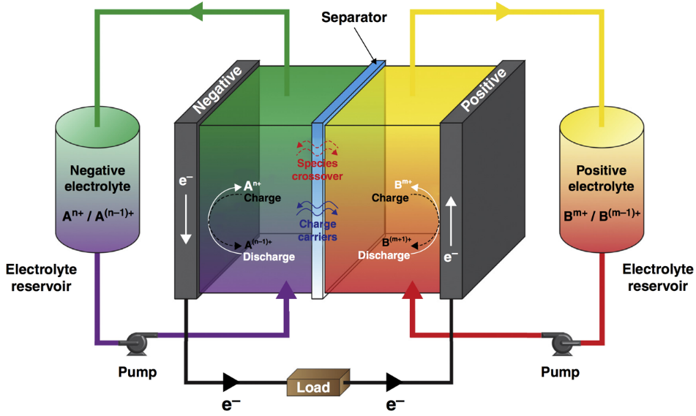
Redox Flow Battery (RFB) as a Stationary Energy Storage System
Advantages:
Separation of energy and power capacity
Integration of intermittent renewable energy sources into the electrical grid
Non-aqueous RFBs potentially yield high energy density and lower cost
Kowalski, Su, Milshtein, Brushett (2016) Current Opinion in Chemical Engineering

Slide 3
Electrode Passivation by Damaged Redoxmers
E.g.:
=
Normal redox cycling
Electrode

Slide 4
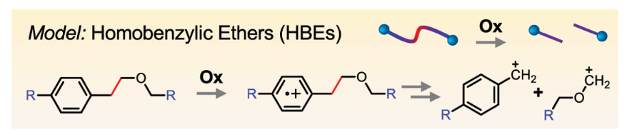
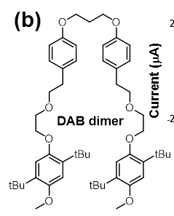
Designing Backbone with Cleavable Tethers
E.g.:
=
Normal redox cycling
Programmed
redox trigger
Electrode
=
Qian, Counihan, Doan, Danis, Setwipatanachai, Purwanto, Rodríguez-López, Assary, Moore. 2020. Under review.
Programmable redox triggered fragmentation removes deposits from electrodes and regenerate active redoxmers

Slide 5
Designing Backbone with Cleavable Tethers
E.g.:
=
Desirable HBEs’ properties:
Suitable redox potential windows
Favorable mesolytic cleavage pathways
High solubility
Ease of synthesis
Electrochemical reversibility
Desirable HBEs’ properties:
Suitable redox potential windows
Favorable mesolytic cleavage pathways
High solubility
Ease of synthesis
Electrochemical reversibility
Normal redox cycling
Programmed
redox trigger
Electrode
=
Qian, Counihan, Doan, Danis, Setwipatanachai, Purwanto, Rodríguez-López, Assary, Moore. 2020. Under review.
Programmable redox triggered fragmentation removes deposits from electrodes and regenerate active redoxmers

Slide 6
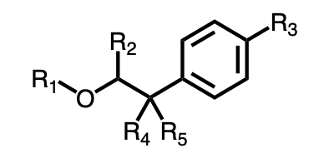

The Challenges
1. Large space of molecular candidates
HBE scaffold
SMILES (Simplified Molecular-Input Line Entry System)
$$\sim$$
﻿[R3]C1=CC=C(C([R4])([R5])C([R2])-[O][R1])C=C1
R₁ = -Me, -Et, -Pr, -Ph, -CN, -Eth, -COMe,
R₂ = -H, -Me, -Ph, -OMe, -Br, -CN
R₃ = -H, Et, -OMe, -N(Me)₂, -CN, -NO₂, -COOMe, -Ph
R₄ , R₅ = -H, -Me, -Ph, CN
> 1000 HBEs
2. Expensive/time-consuming synthesis and characterization

Slide 7
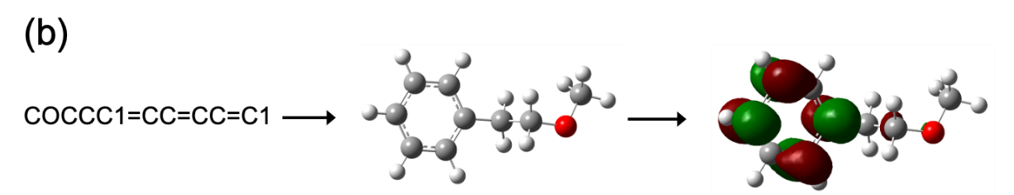
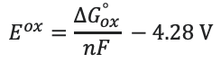
The Opportunities
1. Density Functional Theory (DFT) calculations starting from SMILES
SMILES
3D coordinates
Geometry optimization
E^{ox} calculation
$$E^{ox}=\frac{∆G_{ox}^{°}}{nF} −4.28 V$$
RDKit
Gaussian 16
2. Good agreement between DFT-computed and experimentally measured values
MAE = 0.11 V
1
2
3
4
5
6
7
8
9
10
11
Use DFT calculations to quickly and reliably measure E^{ox} for HBE molecules
7

Slide 8
Problem definition for Machine Learning model
Input
Output/Objective
Molecule candidates
(SMILES library)
Molecules w/ desired oxidation potential
“SMILES.csv”
RDKit
Feature vectors
E.g.
MW | # of C | # of aromatic rings | …
179 | 11 | 1 | …
“features.csv”
125-component vectors

Slide 9
Bayesian optimization scheme
Objective: Given 1000 HBE molecules, find one with maximized E^{ox} within N evaluations
“features.csv”
“SMILES.csv”
Step 1
HBE Library
Features
Initial training data
Surrogate Model Training
SMILES strings
MW, logP, TPSA…
Principle Component Analysis
Gaussian Process Regression
10 random SMILES
with computed E^{ox}
Predicted μ and Σ
Computed E^{ox}
Bayesian optimization
Next SMILES
Acquisition Function Evaluation
E^{ox} Calculation
to test
E.g.: Expected-improvement
DFT simulation
Step 3
Step 2
Code adapted from https://github.com/rajak7/Bayesian_Optimization_Material_design

